Slide 1
Sudoku Solver Algorithm
SAMANDAR KHODJIYEV

Slide 2
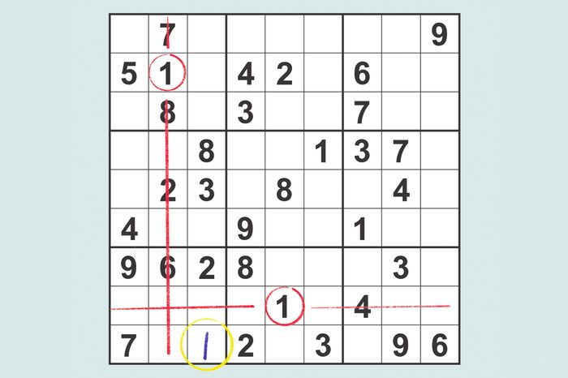
About Project
a puzzle in which missing numbers are to be filled into a 9 by 9 grid of squares which are subdivided into 3 by 3 boxes so that every row, every column, and every box contains the numbers 1 through 9.

Slide 3
Steps to solve the Sudoku problem(pseudocode):BRUTE FORCE
Create a function that checks after assigning the current index the grid becomes unsafe or not. Keep Hashmap for a row, column and boxes. If any number has a frequency greater than 1 in the hashMap return false else return true; hashMap can be avoided by using loops.
Create a recursive function that takes a grid.
Check for any unassigned location. If present then assign a number from 1 to 9, check if assigning the number to current index makes the grid unsafe or not, if safe then recursively call the function for all safe cases from 0 to 9. if any recursive call returns true, end the loop and return true. If no recursive call returns true then return false.
If there is no unassigned location then return true.

Slide 4
Algorithm
One algorithm to solve Sudoku puzzles is the backtracking algorithm. Essentially, you keep trying numbers in empty spots until there aren't any that are possible, then you backtrack and try different numbers in the previous slots.
Complexity Analysis:
Time complexity: O(9^(n*n)). : O(n ^ m) For every unassigned index, there are 9 possible options so the time complexity is O(9^(n*n)). The time complexity remains the same but there will be some early running so the time taken will be much less than the naive algorithm

Slide 5
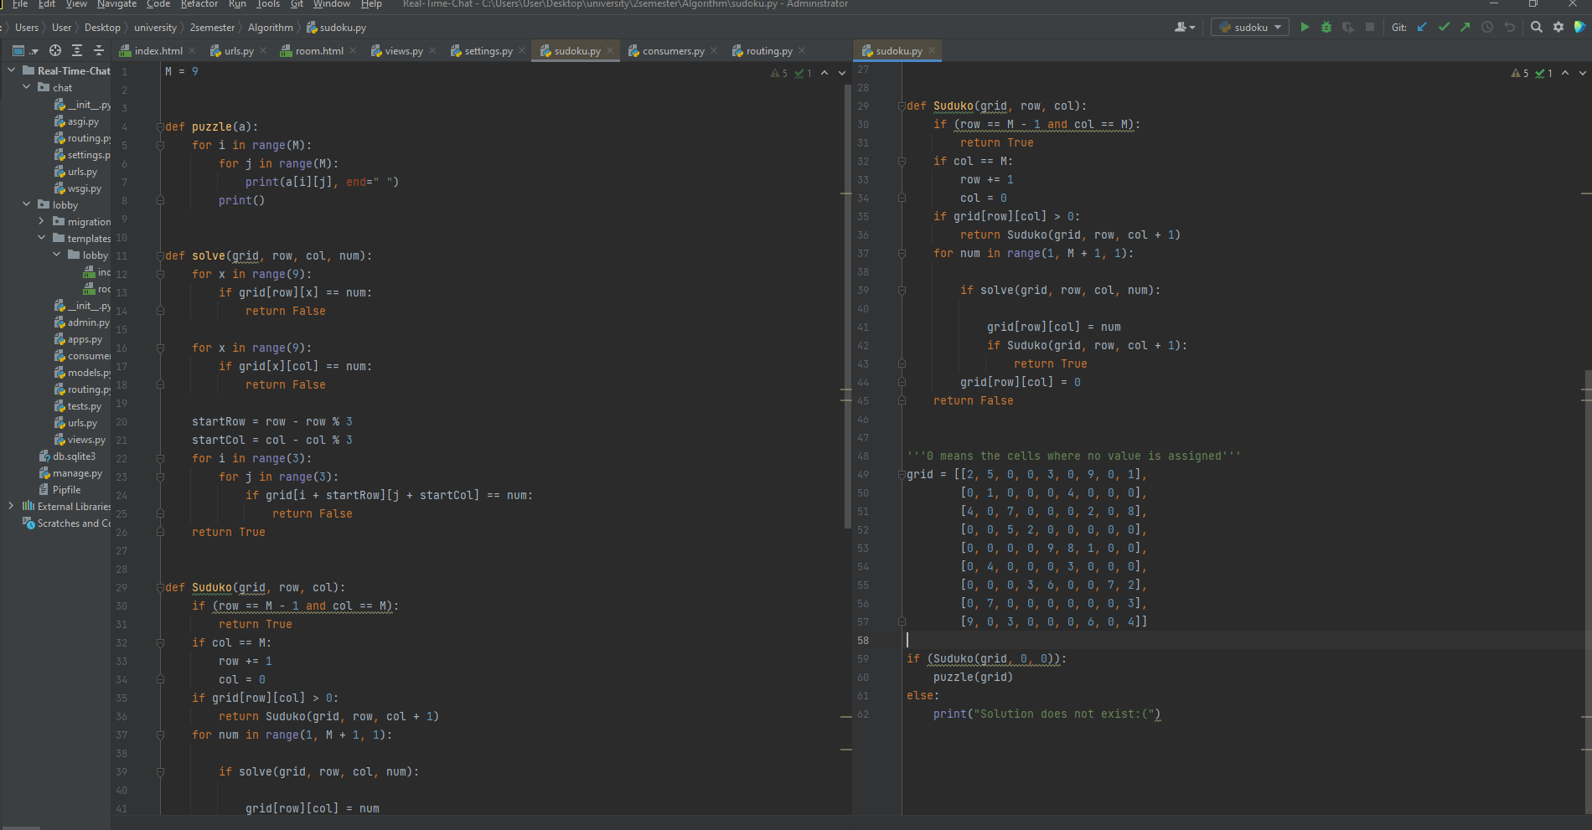
Code

Slide 6
Thank you for attention
Presentation by Khodjiyev Samandar for Algorithm class.

